Slide 1
Blacktown Chinese Christian Church
Welcome to Our English Service 29.06.2025
English Service 9:45 – 11:00 am
Worship Songs: Passage: Speaker: Topic: Response Song: Announcements and Closing Prayer Benediction
Lead me to the cross Good and gracious king How Deep The Fathers Love For Us Josh Groenestyn Jonah TBA

Slide 2
BCCC english service

Slide 3

Please keep all phones on silent

Slide 4
Lead Me To The Cross
Brooke Ligertwood © 2006 Hillsong Music Publishing Australia CCLI Licence No. 5485849 . CCLI Song number: 4785828

Slide 5
Savior I come
Quiet my soul
Remember

Slide 6
Redemption's hill
Where Your blood was spilled
For my ransom

Slide 7
Everything I once held dear
I count it all as loss

Slide 8
Lead me to the cross
Where Your love poured out
Bring me to my knees
Lord I lay me down

Slide 9
Rid me of myself
I belong to You
Oh lead me
Lead me to the cross

Slide 10
You were as I
Tempted and trialled
Human

Slide 11
The word became flesh
Bore my sin and death
Now You're risen

Slide 12
Everything I once held dear
I count it all as loss

Slide 13
Lead me to the cross
Where Your love poured out
Bring me to my knees
Lord I lay me down

Slide 14
Rid me of myself
I belong to You
Oh lead me
Lead me to the cross

Slide 15
To Your heart
To Your heart
Lead me to Your heart
Lead me to Your heart

Slide 16
Lead me to the cross
Where Your love poured out
Bring me to my knees
Lord I lay me down

Slide 17
Rid me of myself
I belong to You
Oh lead me, lead me

Slide 18
Lead me to the cross
Where Your love poured out
Bring me to my knees
Lord I lay me down

Slide 19
Rid me of myself
I belong to You
Oh lead me
Lead me to the cross

Slide 20
Good And Gracious King
CCLI Licence No: 5485849

Slide 21
I approach the throne of glory
Nothing in my hands I bring
But the promise of acceptance
From a good and gracious King

Slide 22
I will give to You my burden
As You give to me Your strength
Come and fill me with Your Spirit
As I sing to You this praise

Slide 23
You deserve the greater glory
Overcome, I lift my voice
To the King in need of nothing
Empty handed I rejoice

Slide 24
You deserve the greater glory
Overcome with joy I sing
By Your love I am accepted
You’re a good and gracious King

Slide 25
O what grace that You would see me
As Your child and as Your friend
Safe, secure in You forever
I pour out my praise again

Slide 26
You deserve the greater glory
Overcome, I lift my voice
To the King in need of nothing
Empty handed I rejoice

Slide 27
You deserve the greater glory
Overcome with joy I sing
By Your love I am accepted
You’re a good and gracious King

Slide 28
Holy, holy, Lord Almighty
Good and gracious
Good and gracious

Slide 29
Holy, holy, Lord Almighty
Good and gracious King

Slide 30
Holy, holy, Lord Almighty
Good and gracious
Good and gracious

Slide 31
Holy, holy, Lord Almighty
Good and gracious King

Slide 32
You deserve the greater glory
Overcome, I lift my voice
To the King in need of nothing
Empty handed I rejoice

Slide 33
You deserve the greater glory
Overcome with joy I sing
By Your love I am accepted
You’re a good and gracious King

Slide 34
How Deep The Father’S Love For Us
Stuart Townend ©1995 Thankyou Music (Admin. by SHOUT! Music Publishing Australia) CCLI Licence No. 5485849 . CCLI Song number: 155810

Slide 35
How deep the Father's love for us
How vast beyond all measure
That He should give His only Son
To make a wretch His treasure

Slide 36
How great the pain of searing loss
The Father turns His face away
As wounds which mar the chosen One
Bring many sons to glory

Slide 37
Behold the Man upon a cross
My sin upon His shoulders
Ashamed I hear my mocking voice
Call out among the scoffers

Slide 38
It was my sin that held Him there
Until it was accomplished
His dying breath has brought me life
I know that it is finished

Slide 39
I will not boast in anything
No gifts, no power, no wisdom
But I will boast in Jesus Christ
His death and resurrection

Slide 40
Why should I gain from His reward?
I cannot give an answer
But this I know with all my heart
His wounds have paid my ransom

Slide 41

Bible reading

Slide 42
Announcements

Slide 43





Account name: Blacktown Chinese Christian Church
Account number: 4216 50263
Offering
BSB: 112 - 879
Please put in "offering" as the reference
The offering box is available at the back of the hall

Slide 44
Prayer points

Slide 45
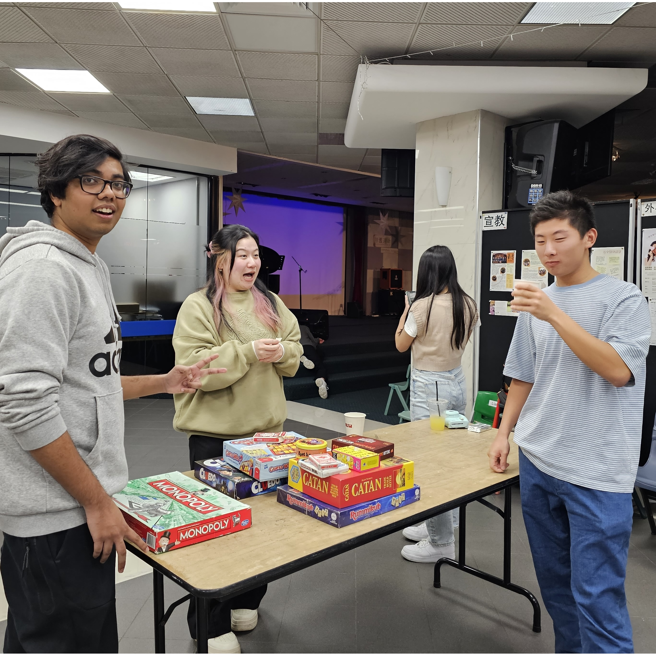
Mingle time!

